Slide 1
IoT framework for Home using Raspberry Pi
Group 14
Kim Yeongjin
Park Jino
Shin Yongmin
Jung hoonsik

Slide 2
CONTENTS
Ⅰ. Purpose
Ⅱ. Overview
Ⅲ. Progressing
Ⅳ. To do

Slide 3
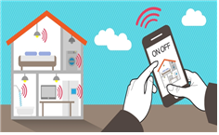
Ⅰ. Purpose
Applying sensors to objects, delivering data in real time, enabling interaction with the Internet without help from humans
Control diversity sensor using raspberry pi
raspberry pi is controlled by web and app
Easy home control for the lives of modern people
1

Slide 4



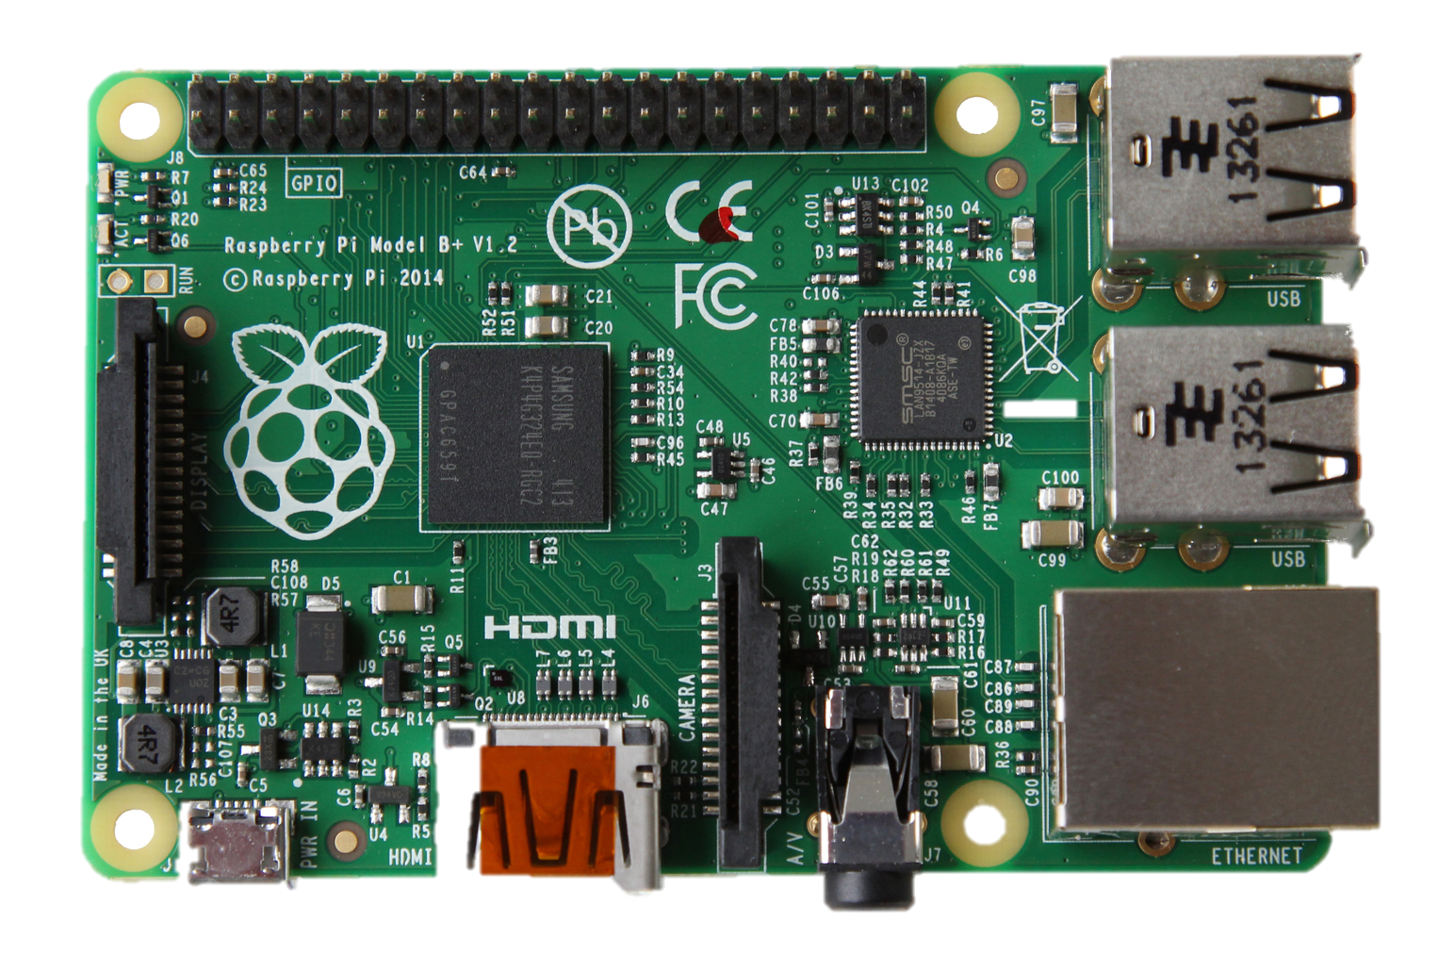
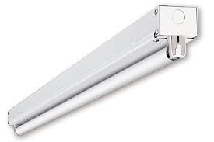
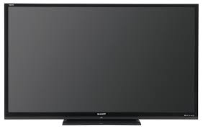
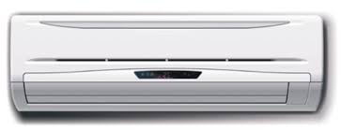
Ⅱ. Overview
Window,
Door
status classification
Blind
Raise / Lower
Fluorescent lamp
Home Appliances
Turn on / Turn off
Control
2

Slide 5

Ⅱ. Overview
Window, Door status classification.
1. Set FSR between window/door and frame.
2. Calculate pressure.
3. If calculated data over standard value, window is open else, window is closed.
3

Slide 6
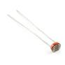

Ⅱ. Overview
Raise or Lower Blind
1. Set Illuminance Sensor at outside of blind
2. Calculate lux.
3. User determines the amount of light that raises and lowers the blinds over time.
4. Raspberry Pi control motor to raises or lower the blind
4

Slide 7
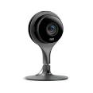
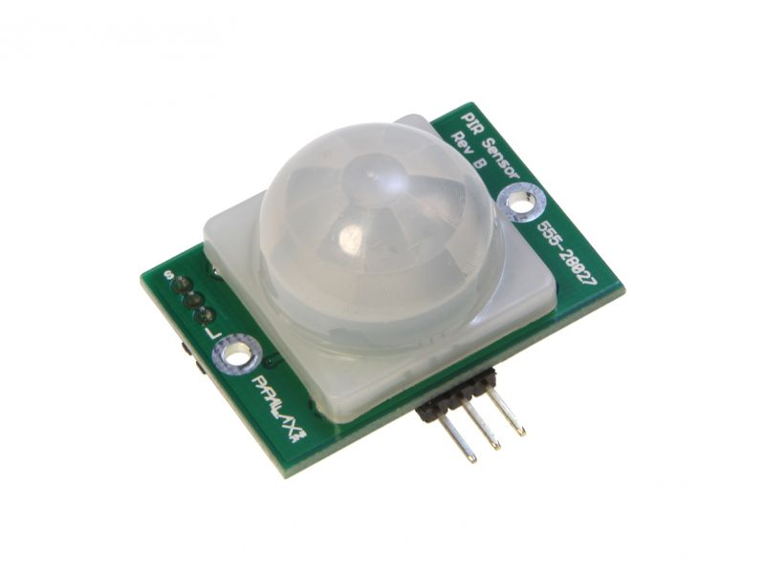
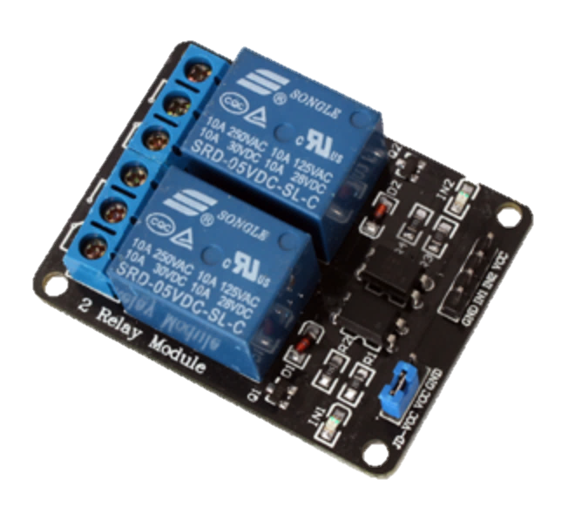
Ⅱ. Overview
Turn on / off Fluorescent lamp
Using PIR sensor PI recognize human’s body, turn on lamp.
Using PIR sensor, Pi recognize human’s body, and If there is no person through camera turn off lamp.
5

Slide 8

Ⅱ. Overview
Control Home Appliances
User Set IR data at Raspberry Pi
Control IR LED using Raspberry Pi using web or android app
6

Slide 9
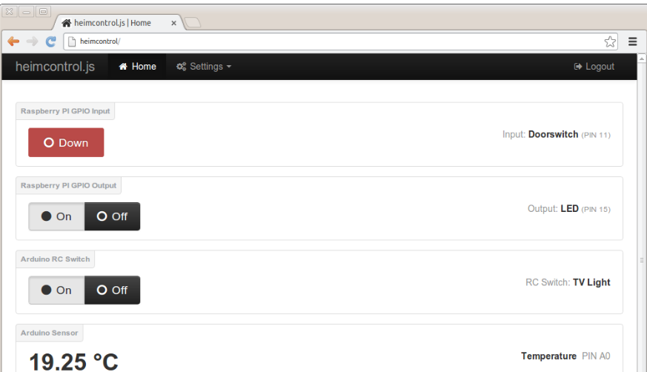

Ⅱ. Overview
Detailed Control / Setting
Voice Control
WEB
Korean / English
Android
Korean / English /
Japanese / Chinese
7

Slide 10
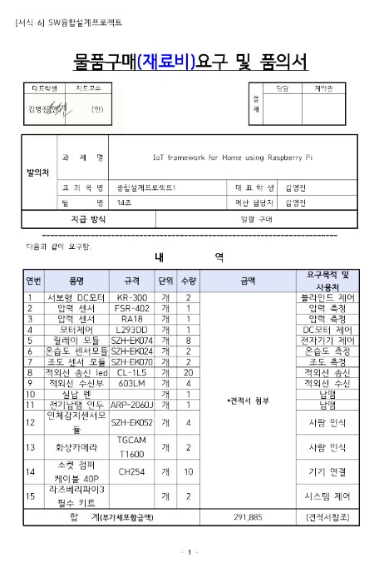
Ⅲ. Progress
Equipment Order
8

Slide 11
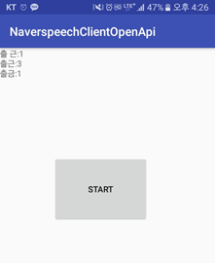
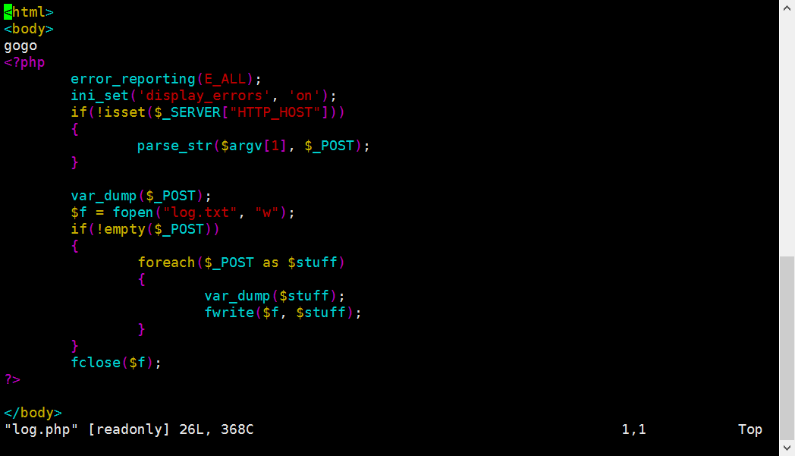
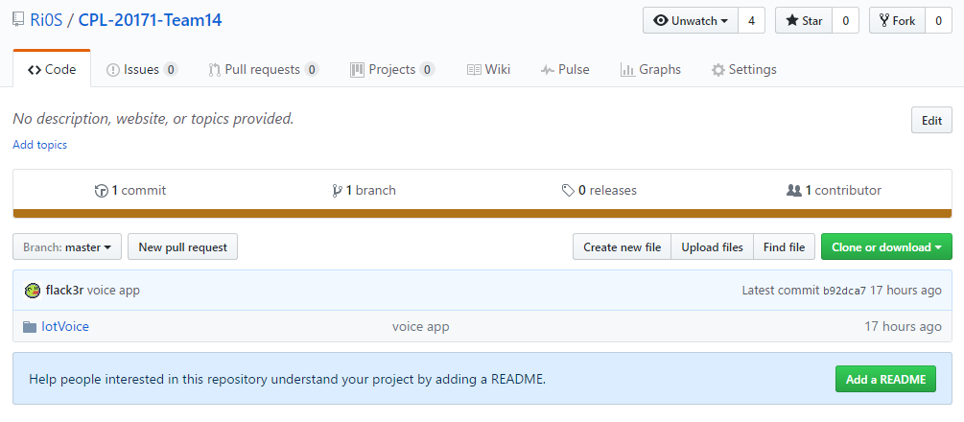
Ⅲ. Progress
Voice Recognition
For voice control
9

Slide 12
Ⅳ. To do
 | 1week | 2weeks | 3weeks | 4weeks | 5weeks | 6weeks | 7weeks | 8weeks | 9weeks | 10weeks | 11weeks | 12weeks | 13weeks | 14weeks | 15weeks
Team building
Subject Confirm
Equipment order
Develop Smart Home
Mid Presentation
Connect Voice Control With System
Prototype Test
Final Presentation
10

Slide 13
Thank You!

